Slide 1







Advent Scripture Carols

Slide 2
Waiting in joyful hope

Slide 3



Waiting in joyful hope
In Advent we’re waiting for Christ our Lord
In Advent we’re waiting for Christ our Lord
With hope and peace and joy and love
In Advent we’re waiting for Christ our Lord
To the tune of Head, Shoulders, Knees and Toes

Slide 4
Waiting in joyful hope
The angel said “the Lord is with you”
The angel said “the Lord is with you”
With hope and peace and joy and love
The angel said “the Lord is with you”
To the tune of Head, Shoulders, Knees and Toes

Slide 5
Waiting in joyful hope
Mary was brave when she said yes to God
Mary was brave when she said yes to God
With hope and peace and joy and love
Mary was brave when she said yes to God
To the tune of Head, Shoulders, Knees and Toes

Slide 6
Waiting in joyful hope
Joseph was kind when he looked after Mary
Joseph was kind when he looked after Mary
With hope and peace and joy and love
Joseph was kind when he looked after Mary
To the tune of Head, Shoulders, Knees and Toes

Slide 7
Waiting in joyful hope
John the Baptist had God’s power upon him.
John the Baptist had God’s power upon him.
With hope and peace and joy and love
John the Baptist had God’s power upon him.
To the tune of Head, Shoulders, Knees and Toes

Slide 8
Waiting in joyful hope
Come Lord Jesus we are waiting for you
Come Lord Jesus we are waiting for you
With hope and peace and joy and love
Come Lord Jesus we are waiting for you
To the tune of Head, Shoulders, Knees and Toes

Slide 9
Isaiah’s Words of Hope
Isaiah 40: 3-5

Slide 10

Isaiah’s Words of Hope
Prepare in the wilderness a road for the Lord!
Clear the way in the desert for our God!
Fill every valley, level every mount,
Prepare in the wilderness a road for the Lord!
To the tune of Incy Wincy Spider

Slide 11
Isaiah’s Words of Hope
Prepare in the wilderness a road for the Lord!
The hills will be a plain and the rough will be made smooth.
Then the glory of the Lord will be revealed to all,
Prepare in the wilderness a road for the Lord!
To the tune of Incy Wincy Spider

Slide 12
Mary is visited by the Angel Gabriel

Slide 13

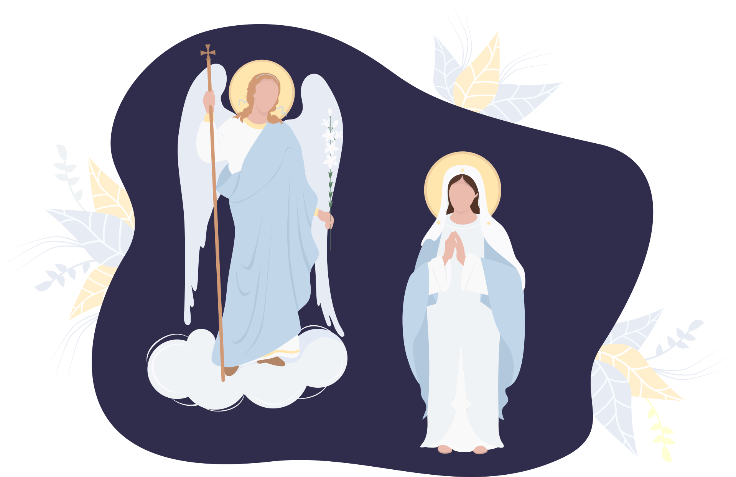
The Annunciation
Mary Mary I’m not scary, you’ll have a son and so,
He’ll be a king, his praise we’ll sing, you are most blessed you know.
Mary Mary, the Lord’s servant, “may it happen as you said so”.
The angel smiled, she was with child, “now to your cousin you must go”.
To the tune of Mary Mary quite contrary

Slide 14
Mary visits Elizabeth

Slide 15
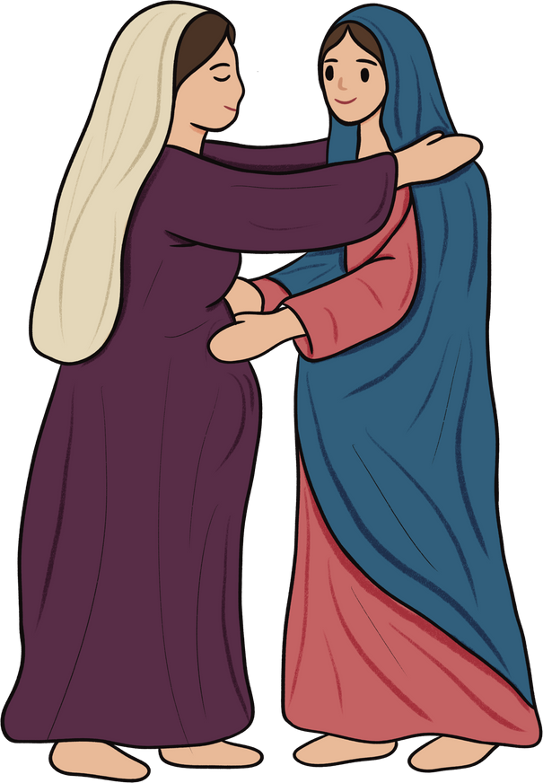
The Visitation
You are the most blessed
O Mary O Mary
When I first heard your greeting my child leapt for joy.
My heart praises the Lord,
my soul’s glad, my soul’s glad
For the Lord has remembered his lowly servant.
To the tune of There’s a hole in my bucket

Slide 16
Joseph has a dream

Slide 17
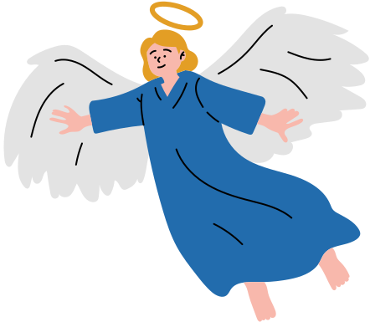
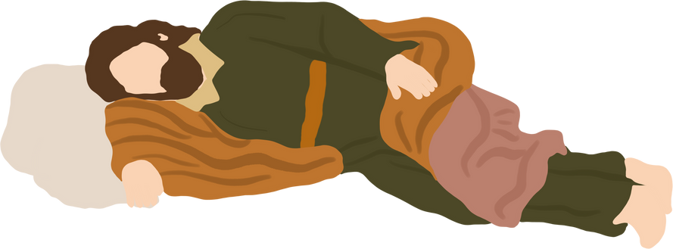
Joseph’s Dream
Joseph was asleep in his bed
when a dream came into his head
‘Stay with Mary and look after her
for Jesus, God’s son, will be in your care.’
‘Stay with Mary’ the angel said to Joseph
Mary and Joseph were soon to be wed,
to fulfil what the prophets had said:
She had a baby and it was a Son,
so all that the angel told Joseph was done.
To the tune of Humpty Dumpty

